Slide 1
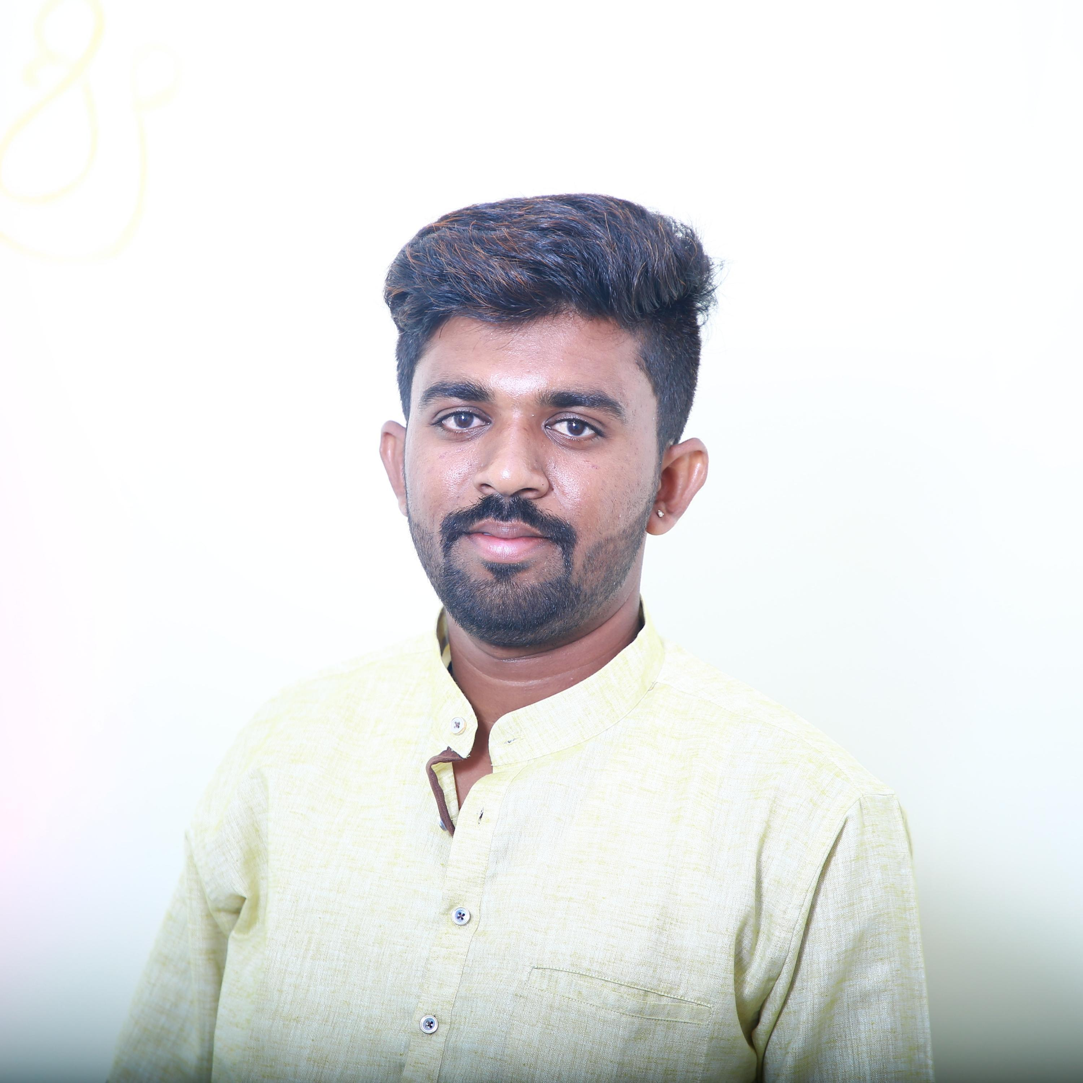
Rohith S
Analyst/Software Engineer
Bachelor of Engineering,
Information Science and Engineering: 2017-2020
BANGALORE
Skills
Rohith.g.s@capgemini.com
JAVA | Basics, OOPS, Exception Handling, Arrays
Web Technologies | HTML5, CSS, Angular JS & React JS
Database | Postgres SQL
Backend | Node JS, REST-API
Tools | Eclipse, Visual Studio Code, POSTMAN
+91 8792940169
A4
Full Stack JAVA Developer
Practical understanding of JavaScript, Angular, React and Node js concepts
Hands on experience in Java Microservice Development using Spring Boot
Ready to learn new technologies/Frameworks and implement them to further improve my knowledge
Good understanding in concepts of JavaScript.
Project:
Online Charity Management is a Web-based charity Management System that leads where a person who has financially more than enough of what he or she needs contributes a part of his or her surplus income for the fulfillment of the needs of those who are less capable. This Charity management system will help to find donors easily.
Technologies used:
React JS
Spring Boot
PostgresSQL

